Slide 1

Anti-Money Laundering Project
Sharad Parmar
Dhrumil Buch
Aayush Khandelwal
Dipsy

Slide 2
Introduction:
In our increasingly digital world, the threat of financial crime looms large, posing serious risks to the stability of financial institutions and the integrity of global economic systems. Our project seeks to address this pressing issue by leveraging machine learning techniques to detect and prevent illicit activities within financial transaction.
"Our project utilizes a comprehensive dataset from Kaggle, titled 'IBM Transactions for Anti Money Laundering (AML)', featuring synthetic financial transactions designed to simulate real-world scenarios.
Key aspects of the dataset include:
Source and Content: Created by IBM to reflect both legitimate and suspicious financial activities.
Size of Dataset: Contains 32 million transactions, offering a robust foundation for analysis and model training.
Data Features: Includes Timestamp, From Bank, From acc, To Bank, To acc, Amount Received, Receiving Currency, Amount Paid, Payment Currency, Payment Format, Is Laundering.

Slide 3
Methodology:
Data Preprocessing:
Normalization: Adjusts the scale of numerical input variables to a fixed range, typically 0 to 1, which prevents data skewness and ensures that all features contribute equally to the model's predictions, improving algorithm stability and performance.
Handling Missing Values: Imputation techniques are used to address gaps in the dataset, ensuring comprehensive data integrity.
Encoding Categorical Variables: Transform categorical data into numerical format through one-hot encoding, enabling proper integration into our model.
Exploratory Data Analysis (EDA):
Conduct an in-depth examination to detect underlying patterns and anomalies that could indicate suspicious activities.
Model Development:
Initial Models: Start with simpler models like Logistic Regression, SVC, and Random Forests to establish a baseline.
Advanced Algorithms: Implement XGBoost for improved prediction accuracy due to their ability to handle complex nonlinear patterns.
Model Evaluation:
Performance Metrics: Assess models using Accuracy, Precision, Recall, and F1-Score to gauge both the efficacy and efficiency of our models in detecting money laundering activities."

Slide 4
Exploratory Data Analysis:
Currency Consistency: The vast majority of transactions, both legitimate and laundering, occur without currency conversion, suggesting that money laundering is not heavily dependent on cross-currency transactions. 98.48% of transactions occur in the same currency, minimizing the complexity of tracking money laundering across currencies.
Preferred Currencies for Laundering: Predominantly in Euros and US Dollars, with the latter used in 40.6% of laundering cases. These currencies are favored due to their wide acceptance and ease of use in large transactions.
Common Payment Methods: ACH transfers are the most common payment method in laundering transactions, despite cheques being the most common overall. This suggests that launderers prefer ACH for its ease, speed or less traceable money movements. Other methods like credit cards and bitcoin are also utilized but to a lesser extent.
Transactional Trends: Laundering transactions peak mid-month, indicating potential timing strategies to evade detection. Legitimate transactions show varied spikes throughout the month, reflecting normal economic activities.

Slide 5
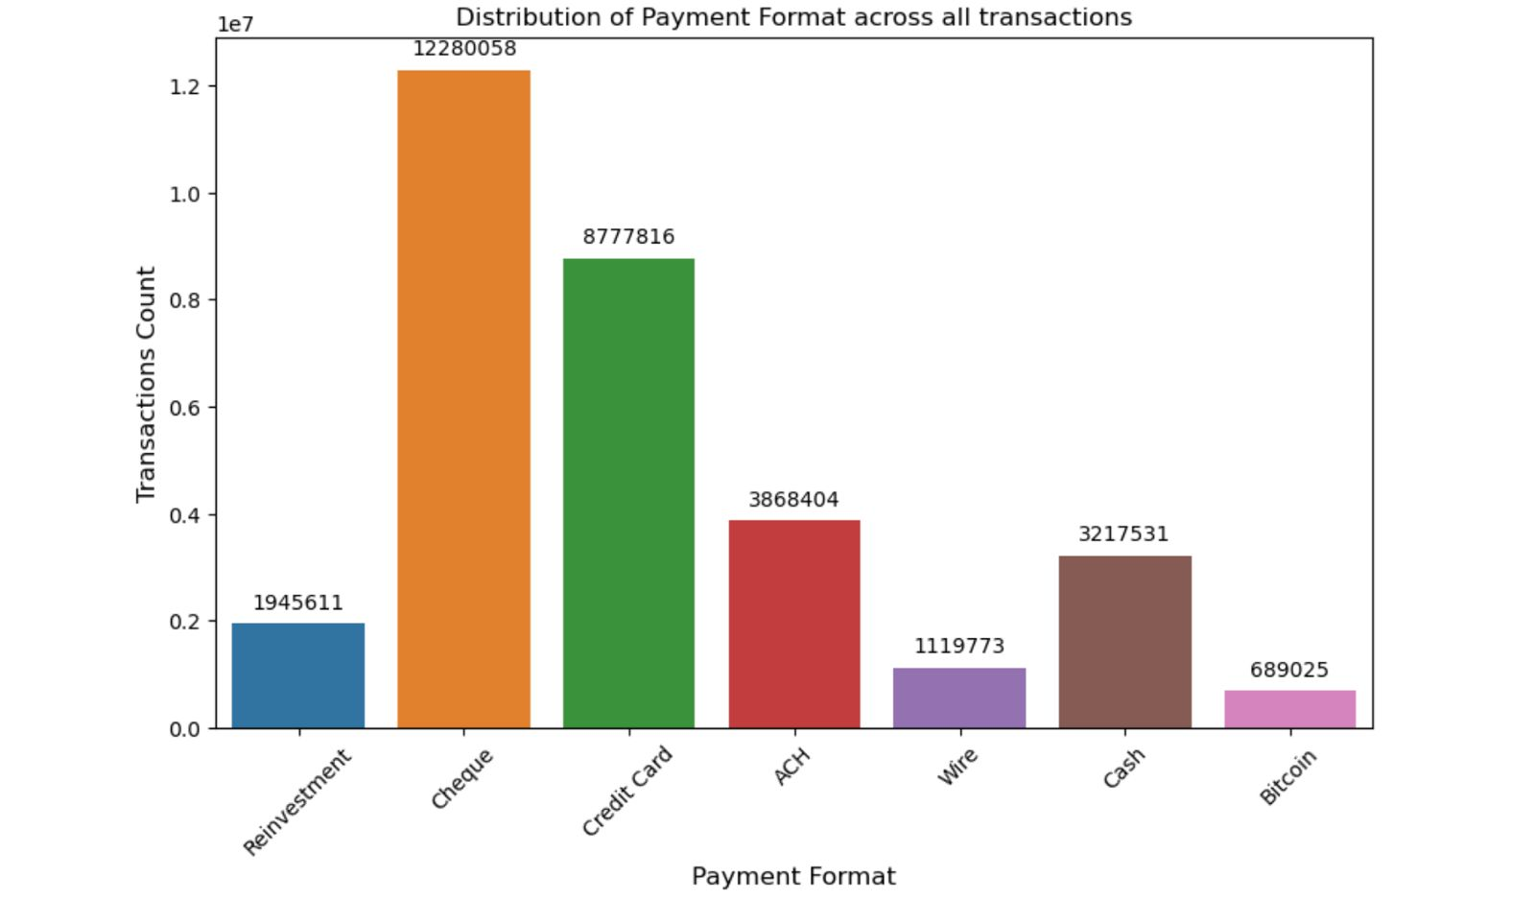
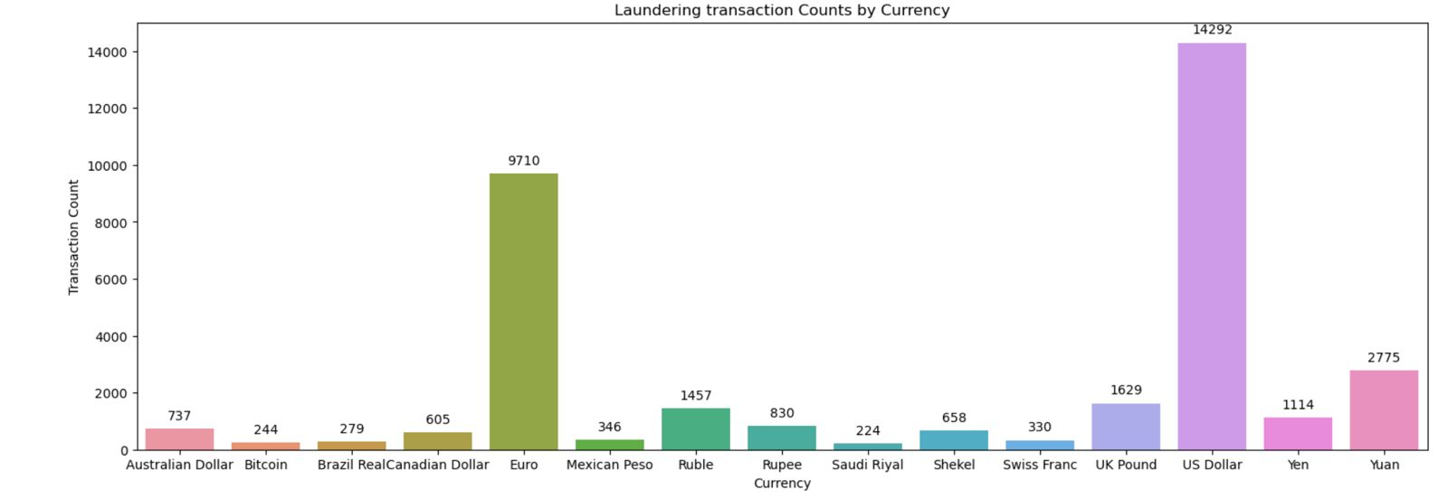
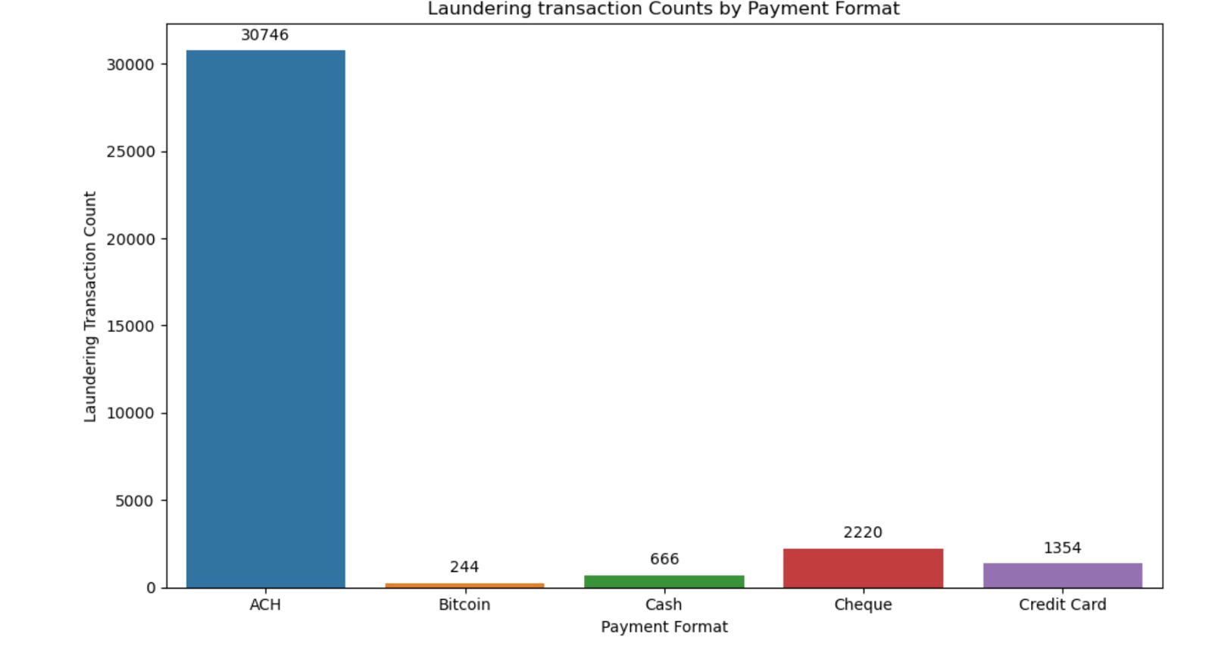
The Euro and US Dollar are most used for laundering, with the US Dollar being the highest with 40.6%.

Slide 6
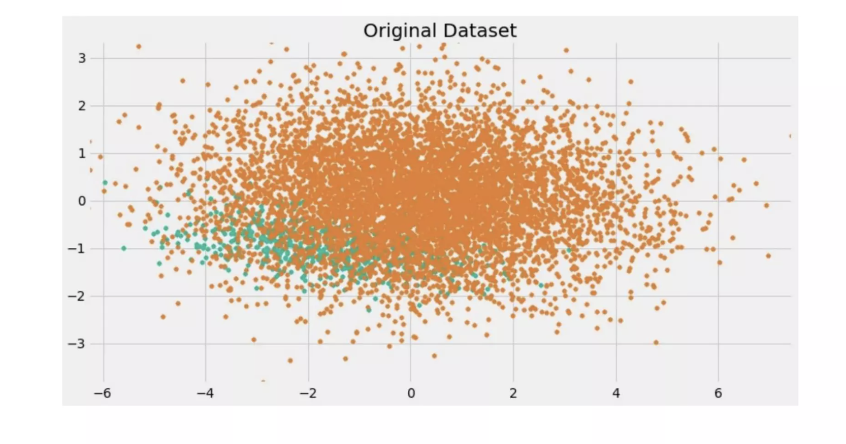

Dealing with Imbalanced Data

Slide 7
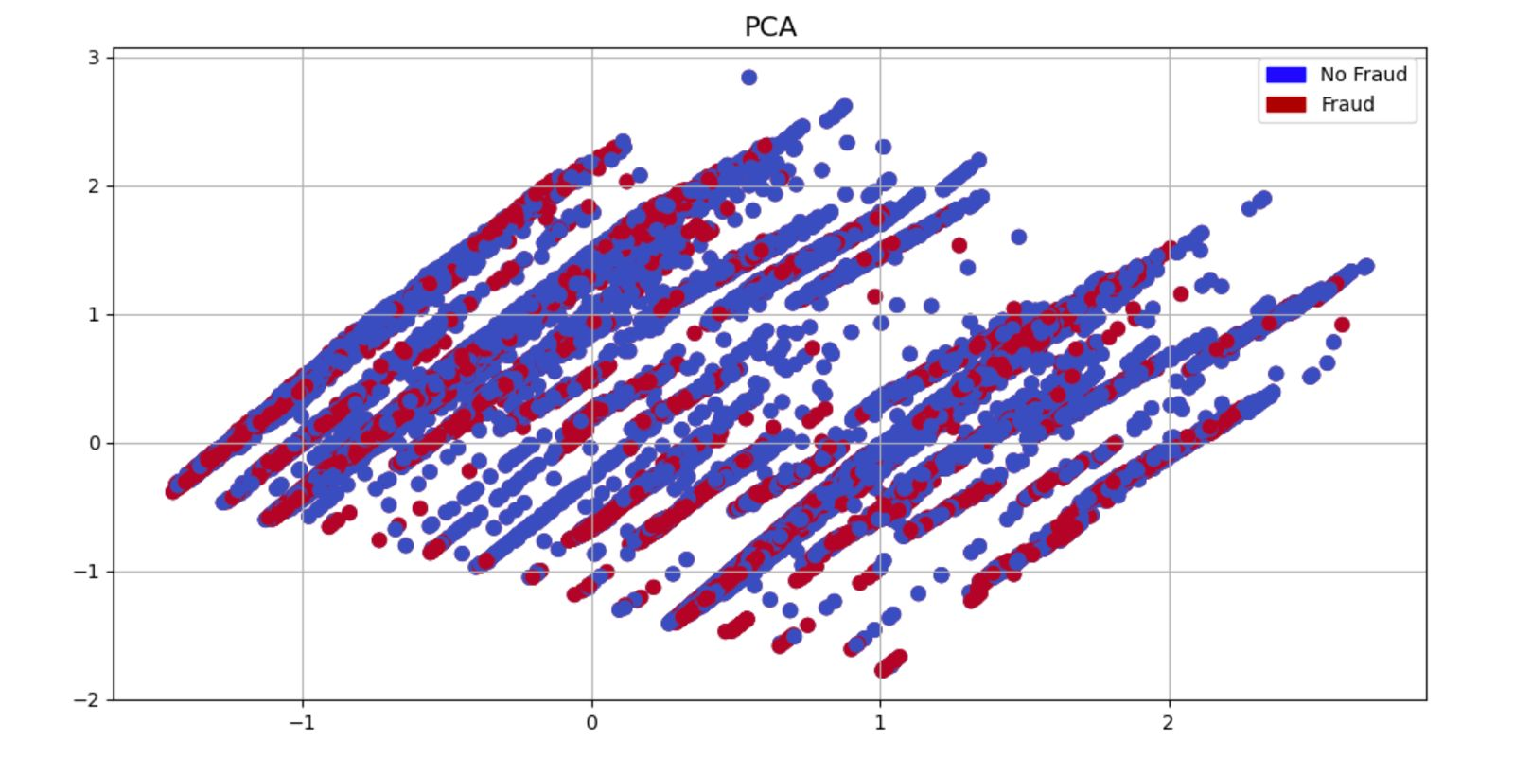
PCA
Financial datasets, like those used for detecting money laundering, often contain a large number of variables. PCA helps reduce the number of variables to a manageable size while retaining the most significant features that explain the bulk of the variance in the dataset.
PCA can help in filtering out noise from the dataset. By keeping only the principal components that explain significant variance, you may discard noise and less informative parts of the data.
PCA helps in understanding which variables contribute most to distinguishing between different classes, such as fraudulent and non-fraudulent transactions.

Slide 8
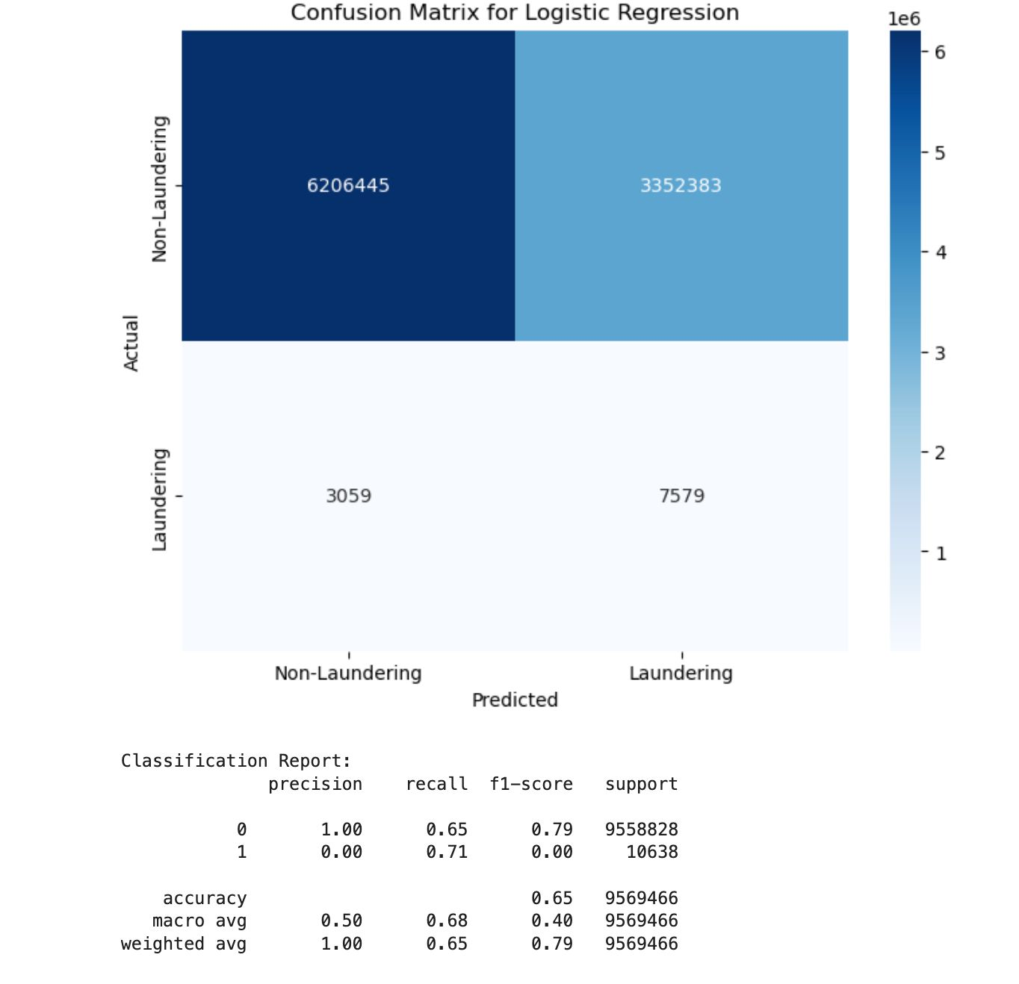
Logistic regression
Interpretability: Logistic Regression provides straightforward interpretation of coefficients, making it easier to understand the impact of each feature on the outcome.
Efficiency: It is computationally efficient, especially with large datasets, and works well when the relationship between features and target variable is linear.
Scalability: Logistic Regression can handle binary classification tasks effectively and is often used as a baseline model for classification problems.

Slide 9
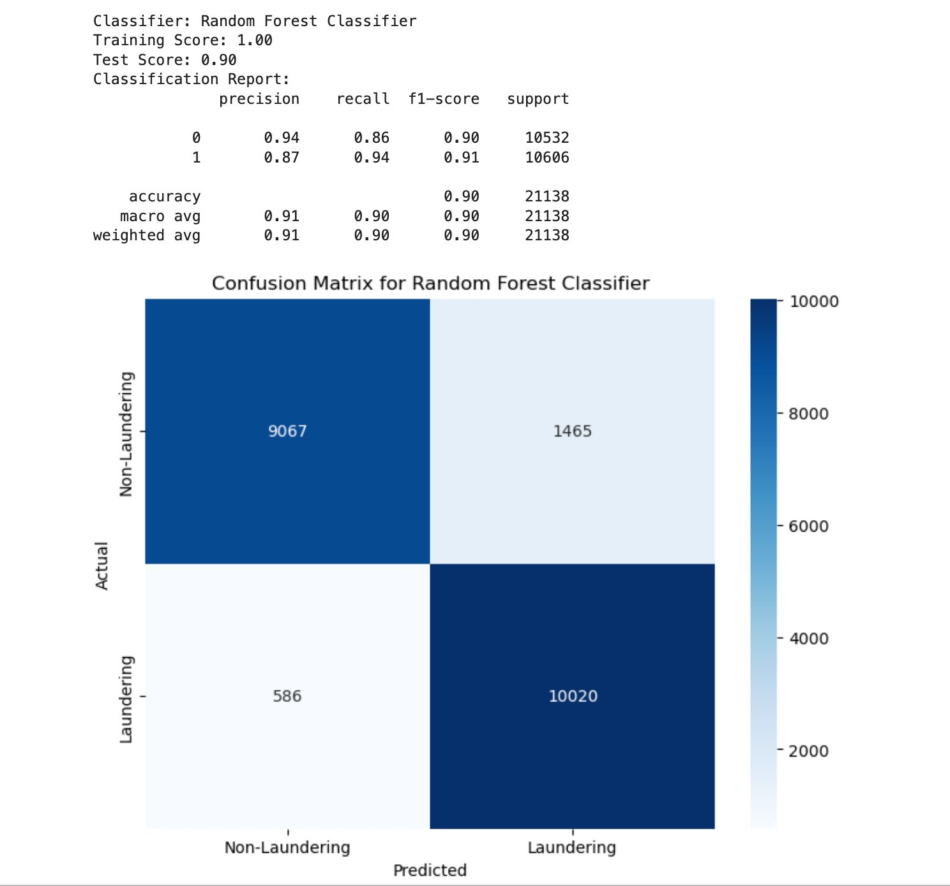
Random Forest
Robustness to Noise and Outliers: Random Forest is robust to noisy and outlier data due to its aggregation of multiple decision trees. It can effectively handle complex and noisy datasets commonly encountered in financial transactions.
Parallel Processing: Random Forest can be easily parallelized, allowing for faster training and prediction times, which is advantageous for real-time or near-real-time money laundering detection systems. Also it provides a method for feature importance selection which can help identify the most relevant features for detecting money laundering activities.

Slide 10
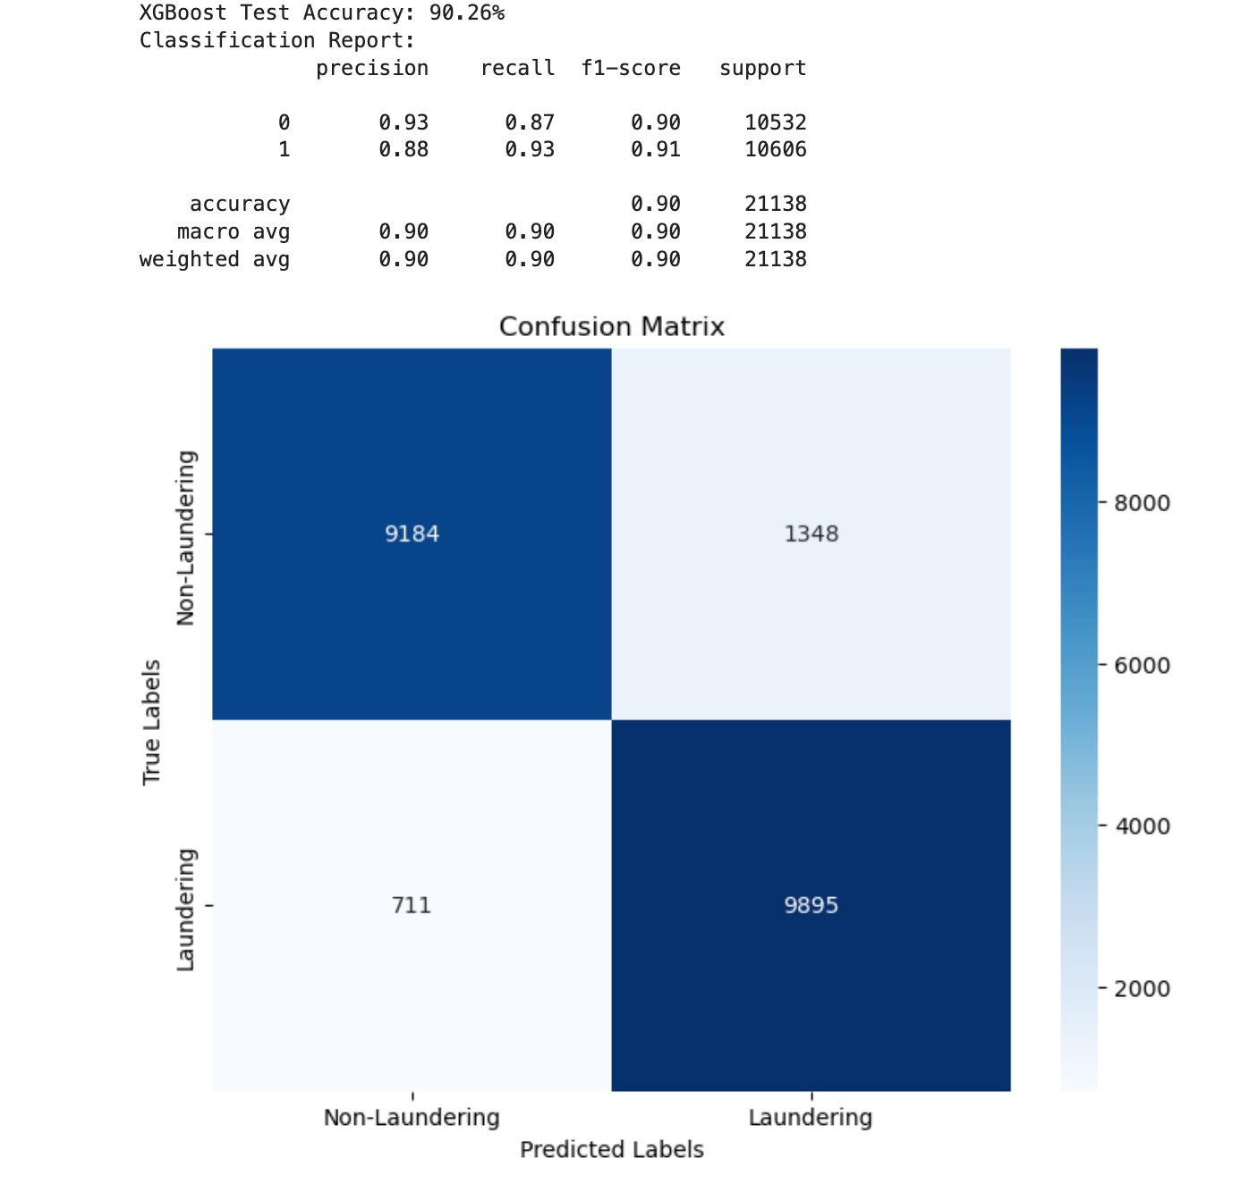
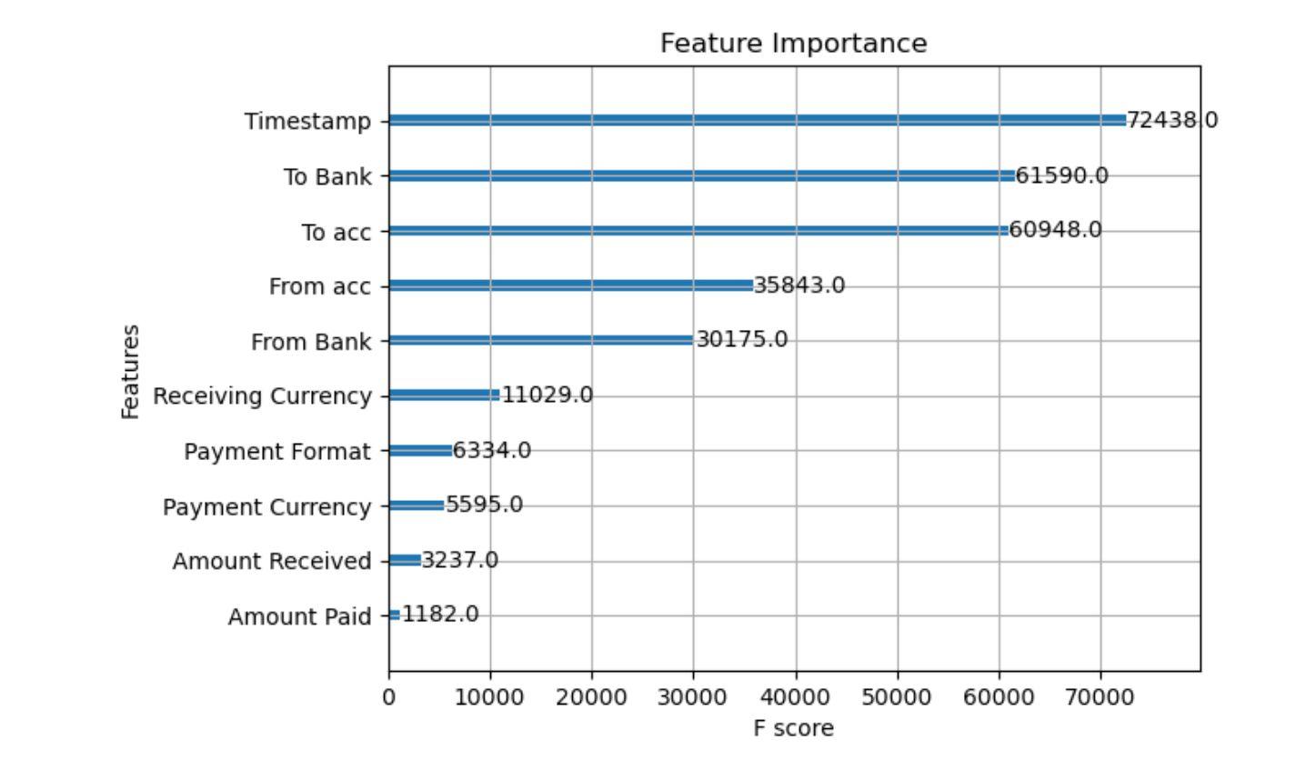
XGBoost
Handling Imbalanced Data: XGBoost is particularly effective in handling imbalanced datasets, which is common in money laundering detection tasks.
Optimized Performance: XGBoost is optimized for performance and efficiency, making it suitable for processing large datasets commonly encountered in financial transactions.

Slide 11
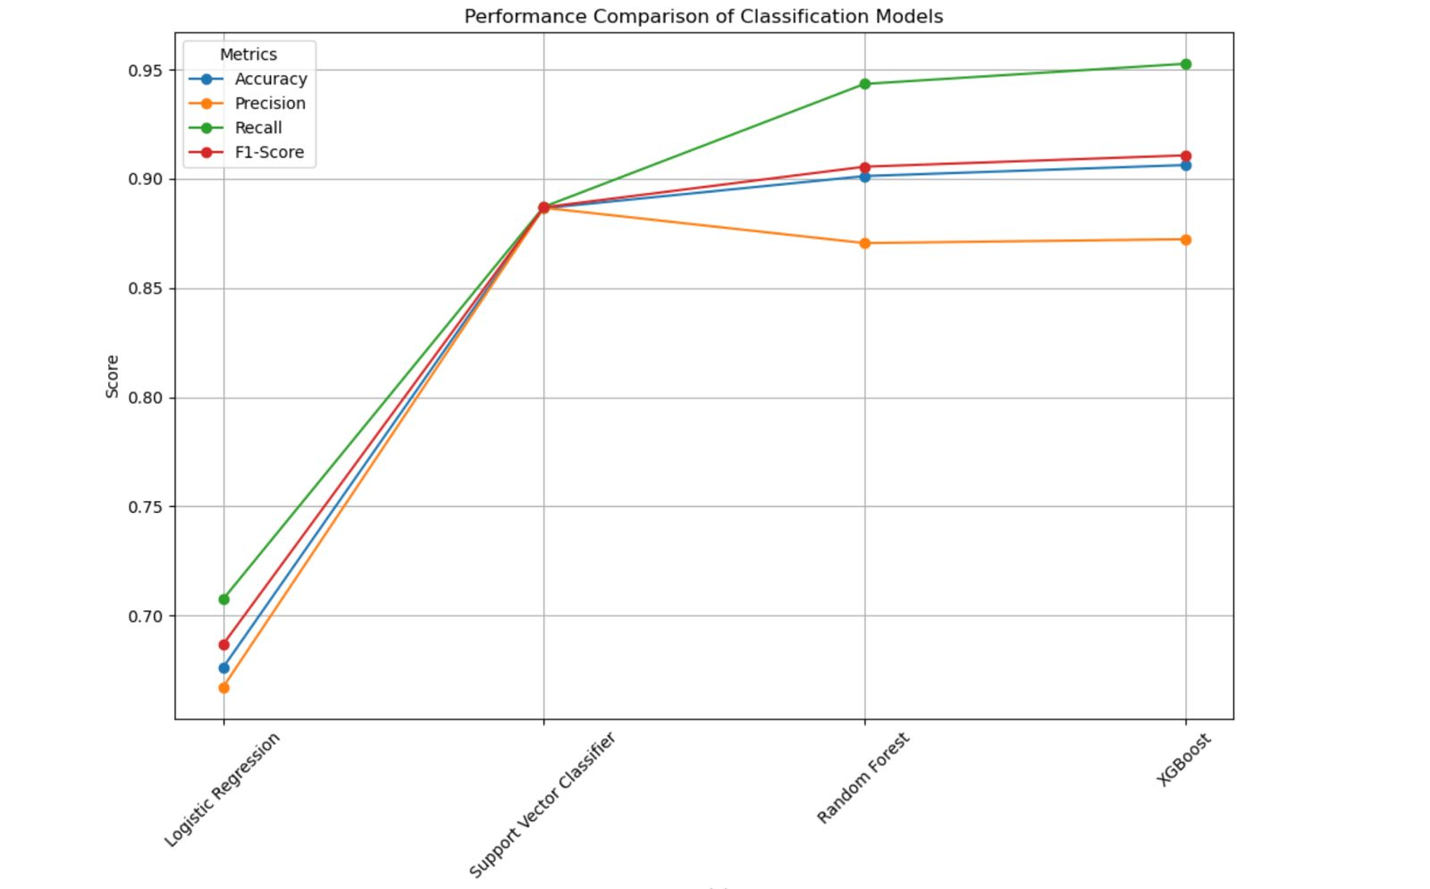
Model Comparison

Slide 12
THANK YOU!

